Slide 1

JUNK
flickr.com/calliope/9070783026
Notes:
Maybe it's because I was packing up the house for the third time in the short span of two years that started me thinking about it. There were boxes I hadn't had the chance to open. Projects and hobbies -- all covered in dust -- that I was filing back away.
That would make sense, that's when I was feeling overwhelmed with all the stuff around me, all this ... junk.

Slide 2
Notes:
"Does having a junk drawer in my application make everything better or worse?"
Because in finding an unequivocal answer to that question could help me find comfort in my current predicament. It may even allow me to rid myself of this "junk" that seemed to follow me with every move.
So I set about on the journey of answering that question.

Slide 3
~ 50 projects
Notes:
I examined close to 50 open source projects. A collection of the top trending and popular projects found on GitHub. A number of them indispensable tools.

Slide 4
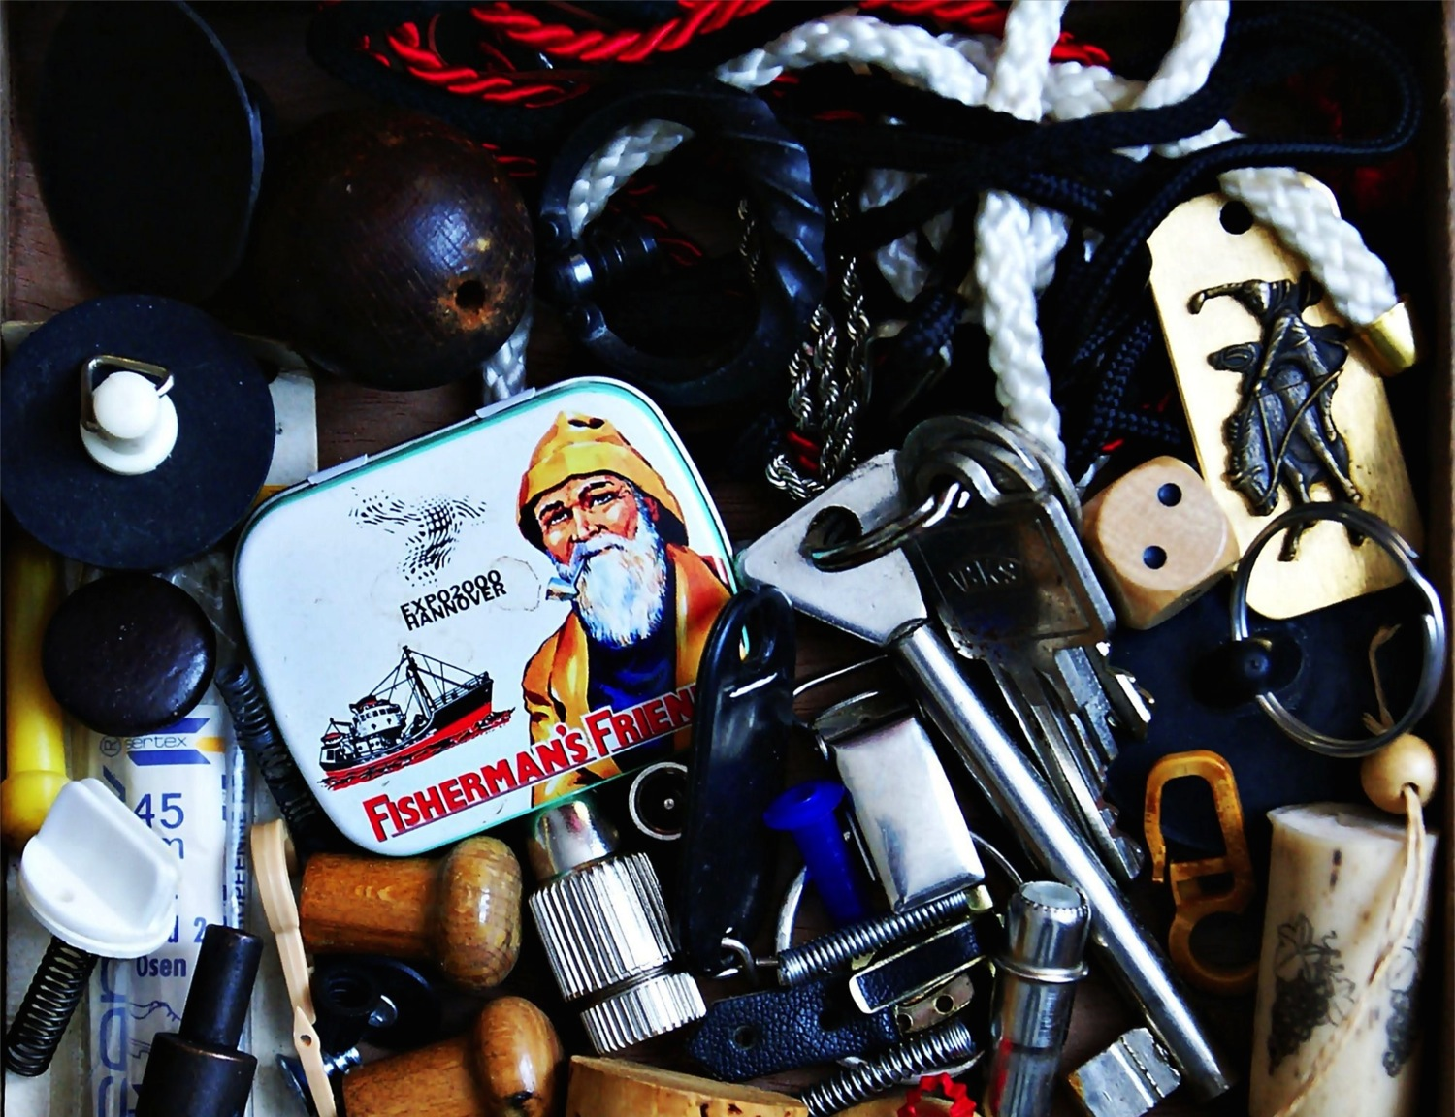
user/repo
Core
Junk
Quality
Quality
flickr.com/eulenfan/13057396724
Notes:
I started by drawing a dividing line through each project.
Source code critical to the mission of the application I labeled "core". What remained -- all the models and methods falling outside of the project's domain -- is what I called "junk".
I had a simple goal. Run code quality analysis on each of these two camps of code and compared their scores.
I used Code Climate to give each of these partitions a score from 0.0 to 4.0. A measure of its quality.
0.0 being the lowest. 4.0 being the highest.
If the quality of the "junk" exceeded the "core" quality, I would conclude that the "junk" was helpful to the project. If it was lower, I would conclude the "junk" had made everything worse.
Each project I examined I hoped to find a wealth of data unanimously supporting one claim over the other. But that I would also stumble upon compelling outliers begging for their story told. Paragons of designs. Exemplars of tragedy.
Instead I found something else.

Slide 5
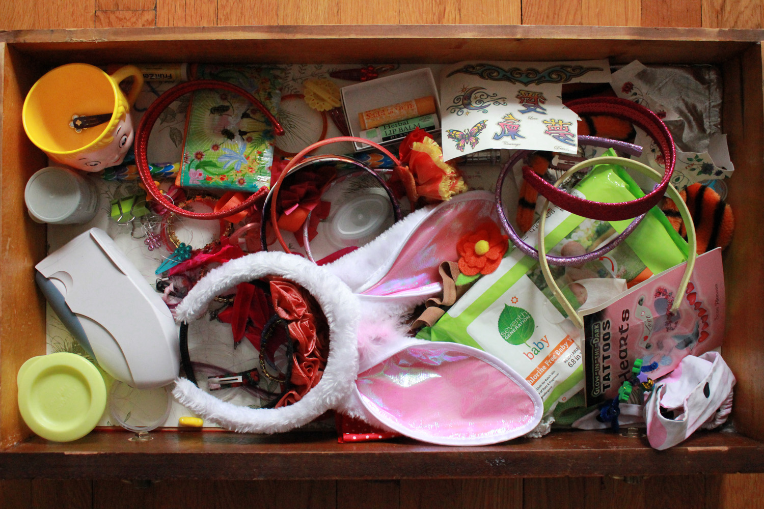
erikhuda/thor
Core
Junk
2.04
3.33
flickr.com/madmishmac/7180307569
Notes:
When I was a teenager, my father lost his job and shortly after his second wife asked for a divorce.
The two of us moved back in with his parents -- my grandparents.

Slide 6
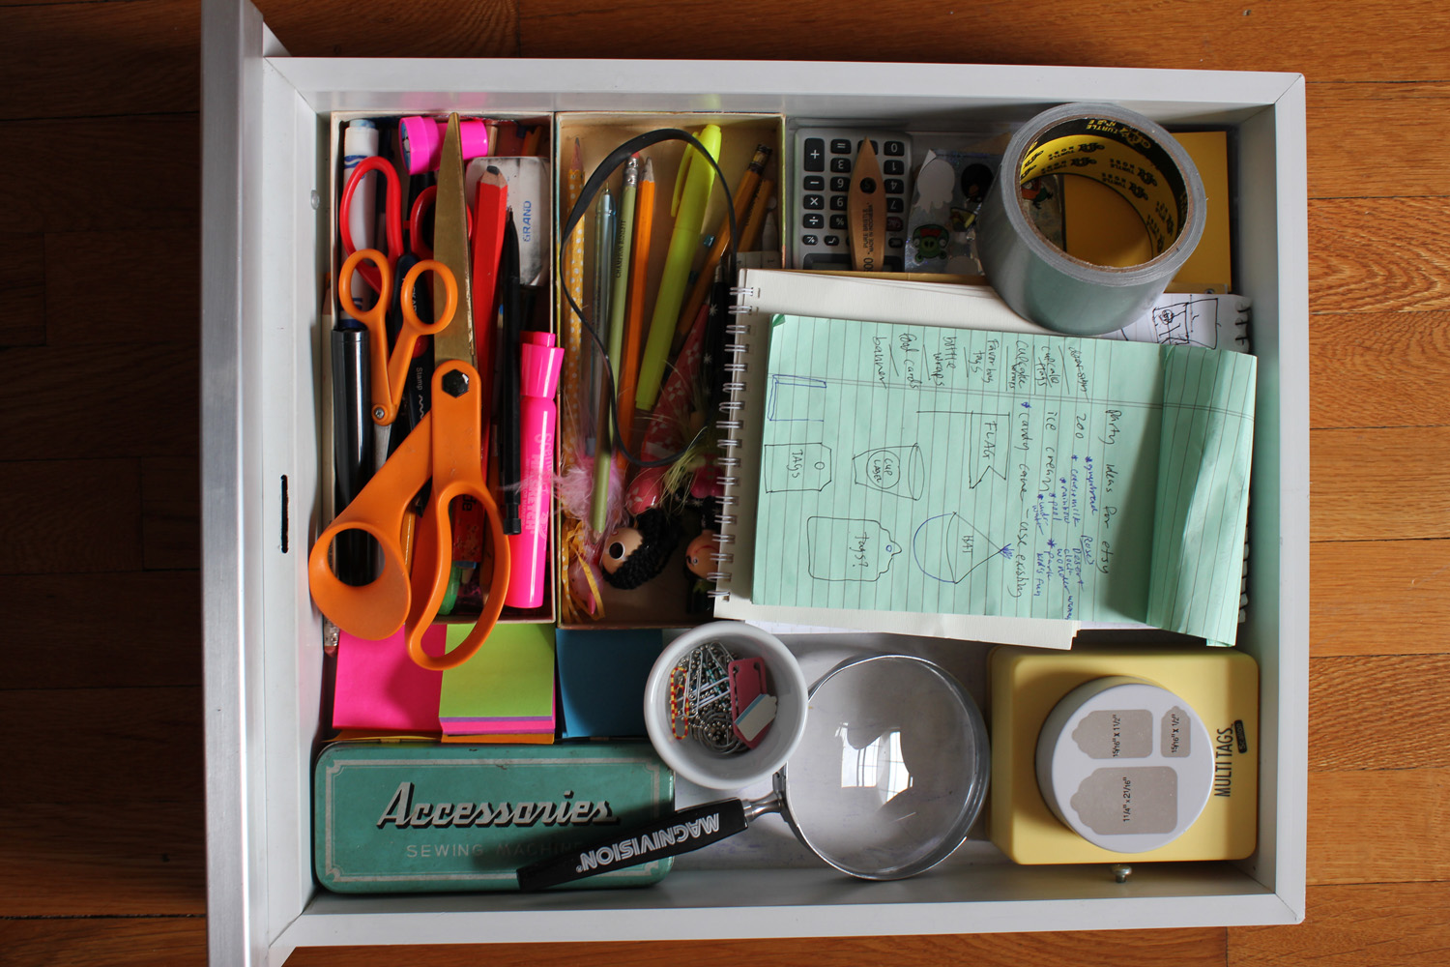
sass/sass
Core
Junk
2.37
2.5
flickr.com/madmishmac/7180306927
Notes:
I slept in the living room. My father on the couch and me on a small bed. We made our home in and around the towering mounds of books, magazines, and knick-knacks spread all throughout the house. Bed sheets, with floral patterns, tucked over top of the overflowing bookcases and draped over long lost tables.

Slide 7
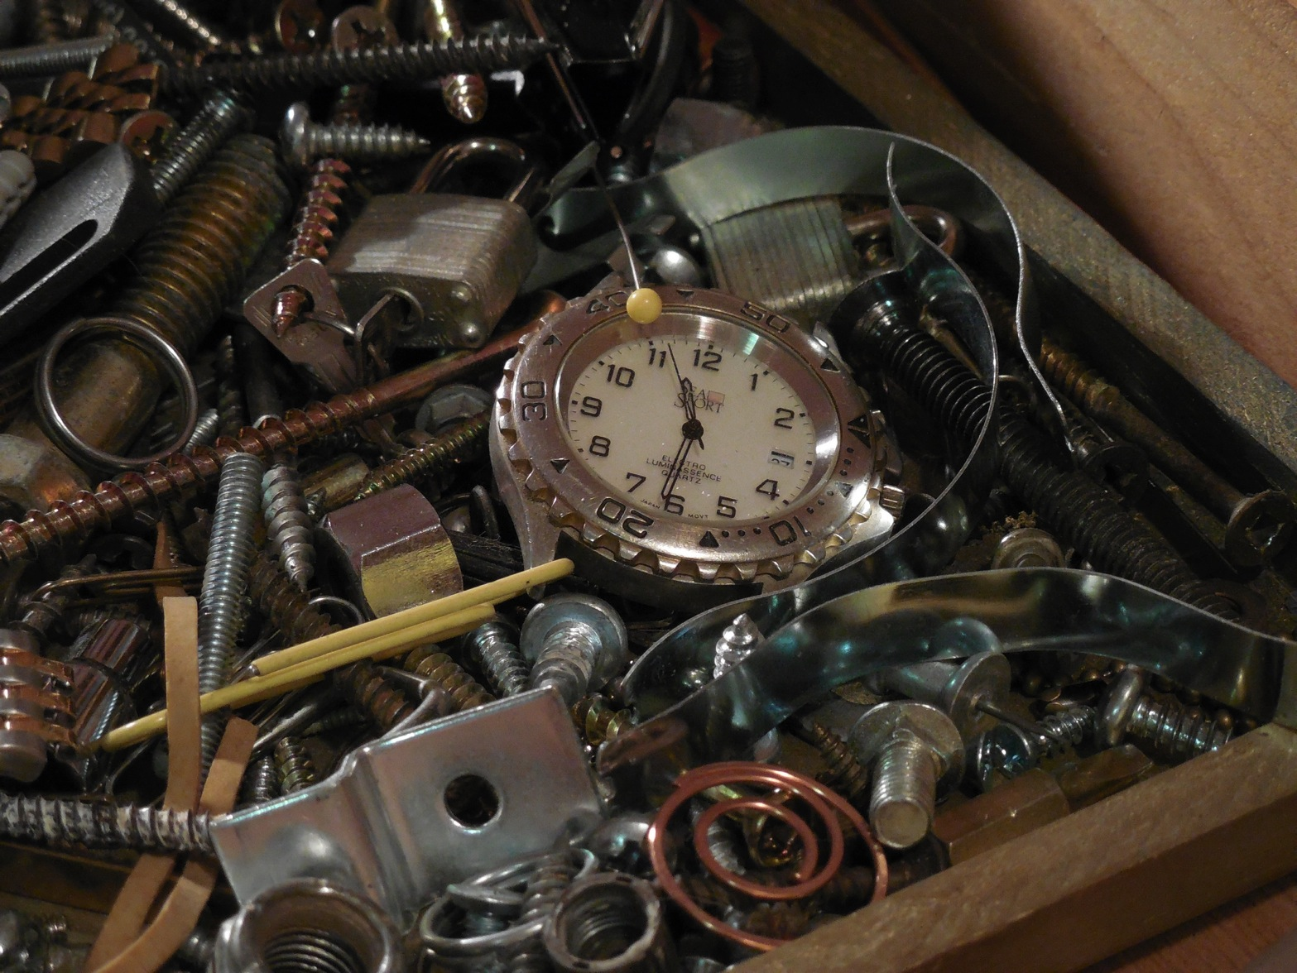
mitchellh/vagrant
Core
Junk
3.62
3.21
flickr.com/11746801@N04/12761961524
Notes:
The living room landscape was ever evolving as these colorfully shrouded dunes grew and shrank. And there somewhere between two dunes lay my bed.
My grandmother was a "junk" collector. In her younger years it was her business. She accepted all manor of things; like books and costume jewelry. Combing through it, sorting it, and then re-selling it to people who would contact here through listings she would place in free circulations.

Slide 8
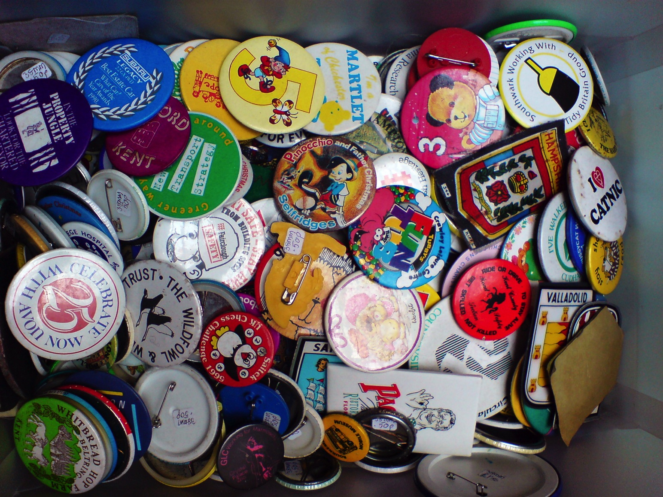
test-kitchen/test-kitchen
Core
Junk
3.44
3.28
flickr.com/willowherb/2482229479
Notes:
It was her obsession. She was a child of the Great Depression.
As she grew older she continued to collect but it became increasingly harder for her to stay ahead of all of it. I was often enlisted to clear tables -- or spaces -- before guests arrived.

Slide 9
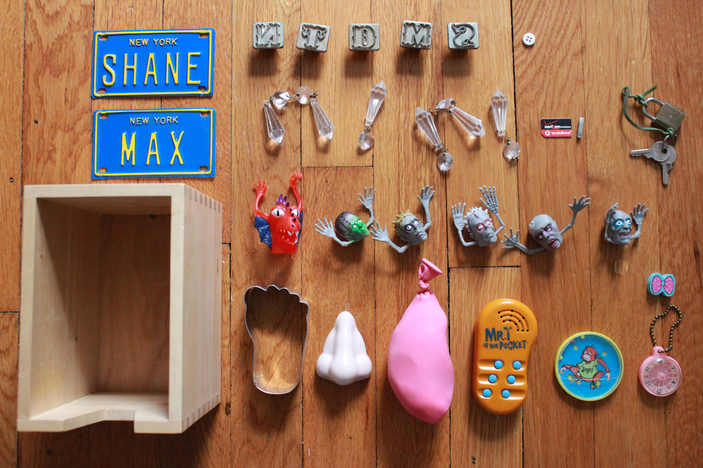
Average All Repos
Core
Junk
3.11
3.47
flickr.com/madmishmac/7365534566
Notes:
... and maybe it's because she passed on recently that I thought about it more - had more questions and more thoughts about the junk she collected.

Slide 10
Notes:
In her absence all of the things that remained became artifacts; meaningful choices made on vacation in a foreign country or treasures from a loved one. Some of it also represented the "junk" she never had a chance to rid herself of.

Slide 11

Treasure
flickr.com/19779889@N00/13065138333
Notes:
"What was the purpose of this junk? What did it do?"
Because an unequivocal answer to that question could help me find comfort in my current predicament. It may even allow me to value the "treasures" that seemed to follow me with every move.
So I set about on another journey of answering that question.

Slide 12
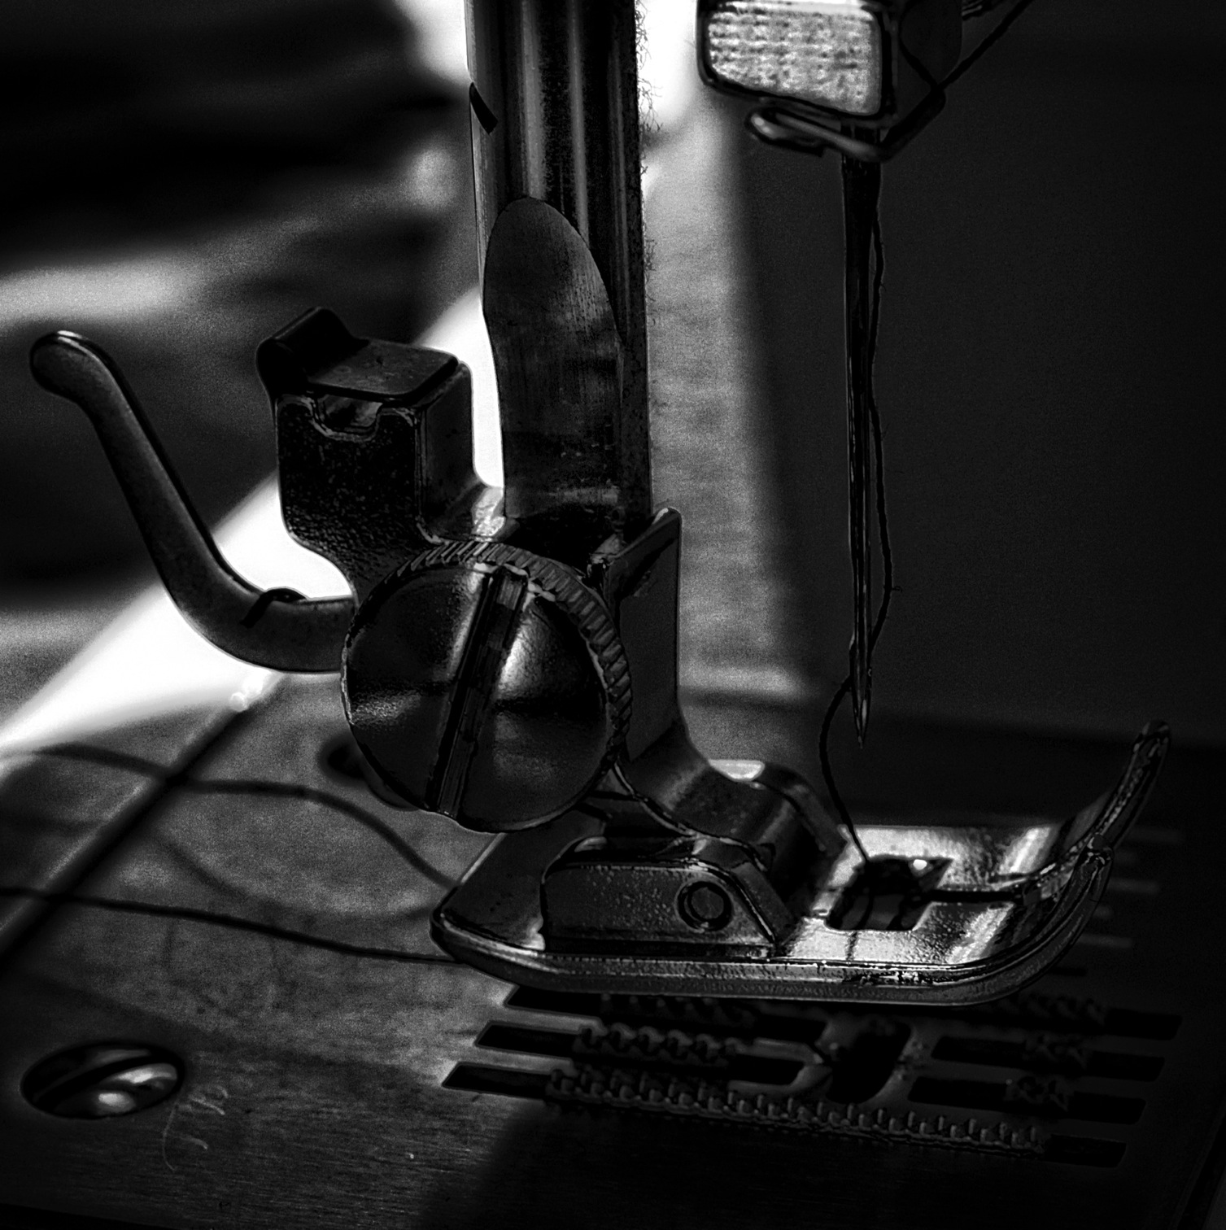
Core Extensions
flickr.com/19779889@N00/11672311463
Notes:
String#snake_case, String#undent, Numeric#to_degrees, Numeric#to_radians
There is so much more to the code we write. It expresses our selves and our understanding of the world... and it expresses how we wish we could change the world.

Slide 13

Backwards Compatibility
flickr.com/19779889@N00/12593276135
Notes:
Hashes that order keys, Random, exist/exists?

Slide 14

HashWithIndifferentAccess
flickr.com/19779889@N00/13087691523
Notes:
Rails, Thor and Vagrant.

Slide 15
Thor::Util.user_home
1
2
3
4
5
6
7
8
9
10
…
def user_home # rubocop:disable MethodLength
@@user_home ||= if ENV["HOME"]
ENV["HOME"]
elsif ENV["USERPROFILE"]
ENV["USERPROFILE"]
elsif ENV["HOMEDRIVE"] && ENV["HOMEPATH"]
File.join(ENV["HOMEDRIVE"], ENV["HOMEPATH"])
elsif ENV["APPDATA"]
ENV["APPDATA"]
else

Slide 16
Thor::Util.user_home
…
11
12
13
14
15
16
17
18
19
20
2122
begin
File.expand_path("~")
rescue
if File::ALT_SEPARATOR
"C:/"
else
"/"
end
end
end
end

Slide 17
jimweirich/rake
1
2
3
4
5
6
7
8
9
10
11
class Module
def rake_extension(method)
if instance_methods.include?(method)
$stderr.puts "WARNING: Possible conflict with …
else
yield
end
end
end

Slide 18
jimweirich/rake
1
2
3
4
5
6
7
8
9
class String
rake_extension("ext") do
def ext(newext='')
# ... implementation
end
end
end

Slide 19
Question
Notes:
Are they not useful enough to share?
Are these examples too small to create gems out of them?

Slide 21
Kitchen::LazyHash
Notes:
Test Kitchen’s LazyHash or Vagrant’s Registry

Slide 22
Kitchen::LazyHash
1
2
3
4
5
context = "any object"
lazy = Kitchen::LazyHash.new({}, context)

Slide 23
Kitchen::LazyHash
1
2
3
4
5
context = "any object"
lazy = Kitchen::LazyHash.new({}, context)
lazy[:length] = ->(c) { c.length }

Slide 24
Kitchen::LazyHash
1
2
3
4
5
context = "any object"
lazy = Kitchen::LazyHash.new({}, context)
lazy[:length] = ->(c) { c.length }
puts lazy[:length] # => 10

Slide 25
Vagrant::Util::Busy

Slide 26
Vagrant::Util::Busy
1
2
3
4
5
6
7
8
9
10
open_connection!
while connected
print "> "
input = STDIN.gets
execute(input)
end

Slide 27
Vagrant::Util::Busy
1
2
3
4
5
6
7
8
9
10
closer = lambda { close_connection! ; exit }
open_connection!
while connected
print "> "
input = STDIN.gets
execute(input)
end

Slide 28
Vagrant::Util::Busy
1
2
3
4
5
6
7
8
9
10
closer = lambda { close_connection! ; exit }
Vagrant::Util::Busy.busy(closer) do
open_connection!
while connected
print "> "
input = STDIN.gets
execute(input)
end
end

Slide 29
ActiveSupport::Dependencies::WatchStack

Slide 30
ActiveSupport::Dependencies::WatchStack
Prepare the Watcher
Load the Files
Mark Constants as Unloadable

Slide 31
Prepare the Watcher
1
2
3
4
5
6
7
8
9
def watcher
@watcher ||= ActiveSupport::Dependencies::WatchStack.new
end
def prepare_watcher!
ActiveSupport::Dependencies.clear
watcher.watch_namespaces([ Object ])
end

Slide 32
Load the Files
1
2
3
4
def load_files
files = Dir[“lib/**/*.rb"]
files.each { |file| require_or_load file }
end

Slide 33
Mark Constants as Unloadable
1
2
3
def mark_constants_as_unloadable
watcher.new_constants.each { |constant| unloadable constant }
end

Slide 34
ActiveSupport::Dependencies::WatchStack
1
2
3
4
5
6
7
8
9
10
11
12
13
14
15
def reload!
prepare_watcher!
load_files
mark_constants_as_unloadable
end

Slide 35
ActiveSupport::Dependencies::WatchStack
1
2
3
4
5
6
7
8
9
10
11
12
13
14
15
require 'listen'
def reload!
prepare_watcher!
load_files
mark_constants_as_unloadable
end
def watch_filepaths(filepaths)
listener = Listen.to(*filepaths) do |mod,add,rem|
reload!
end
listener.start
end

Slide 36
ActiveSupport::Dependencies::WatchStack
1
2
3
4
5
6
7
8
9
10
11
12
13
14
15
require 'listen'
def reload!
prepare_watcher!
load_files
mark_constants_as_unloadable
end
def watch_filepaths(filepaths)
listener = Listen.to(*filepaths) do |mod,add,rem|
reload!
end
listener.start
end
Thread.new { watch_filepaths("lib") }

Slide 38
Question
Notes:
Perhaps these examples are still too small for you to consider their own gems. But for those of you, like me, that could could see uses for theses – why were gems not created?
Is it too difficult to create a gem because of our documentation or tools?
If its not too difficult to create a gem, is it hard to manage dependencies?
And if managing dependencies is not hard, is it too hard then to find these dependencies that we might use?

Slide 39
DRY
Notes:
Why in a culture so dedicated to the principles of DRY are we re-creating certain functions and data structures?

Slide 40
DRY*
* DOES NOT APPLY WHEN WORKING IN A DIFFERENT PROJECT
Notes:
Maybe we do care about DRY but not when it it is code outside of our current domain.
Perhaps when we are singularly focused on delivery some functionality we try not think about how pieces might be used outside of our projects.

Slide 41
DRO
DON’T REPEAT OURSELVES
Notes:
I could create a not quite a as catchy acronym that tries guilt those of you here listening to me into keeping that in mind the next time you return to your existing projects.
Maybe we, as the authors of this code, think what we have written is actually junk. Unusable in another context.

Slide 52
microrb
no gem too small
Notes:
Some people don’t think so at least this project doesn’t think that a gem with a small focus is not a bad gem or a useless one.

Slide 54

better || worse
flickr.com/19779889@N00/12910103635
Notes:
Within the "junk" I found so much more than a binary judgment. Better. Worse.
What I didn't expect to find were all the useful tools and interesting ideas within these junk drawers. Tools confined to the junk drawer because either our framework or our tools or practices still make it less than trivial to manage them. Ideas shared across so many projects -- repeating patterns -- suggesting to me that there may be more truths.

Slide 55
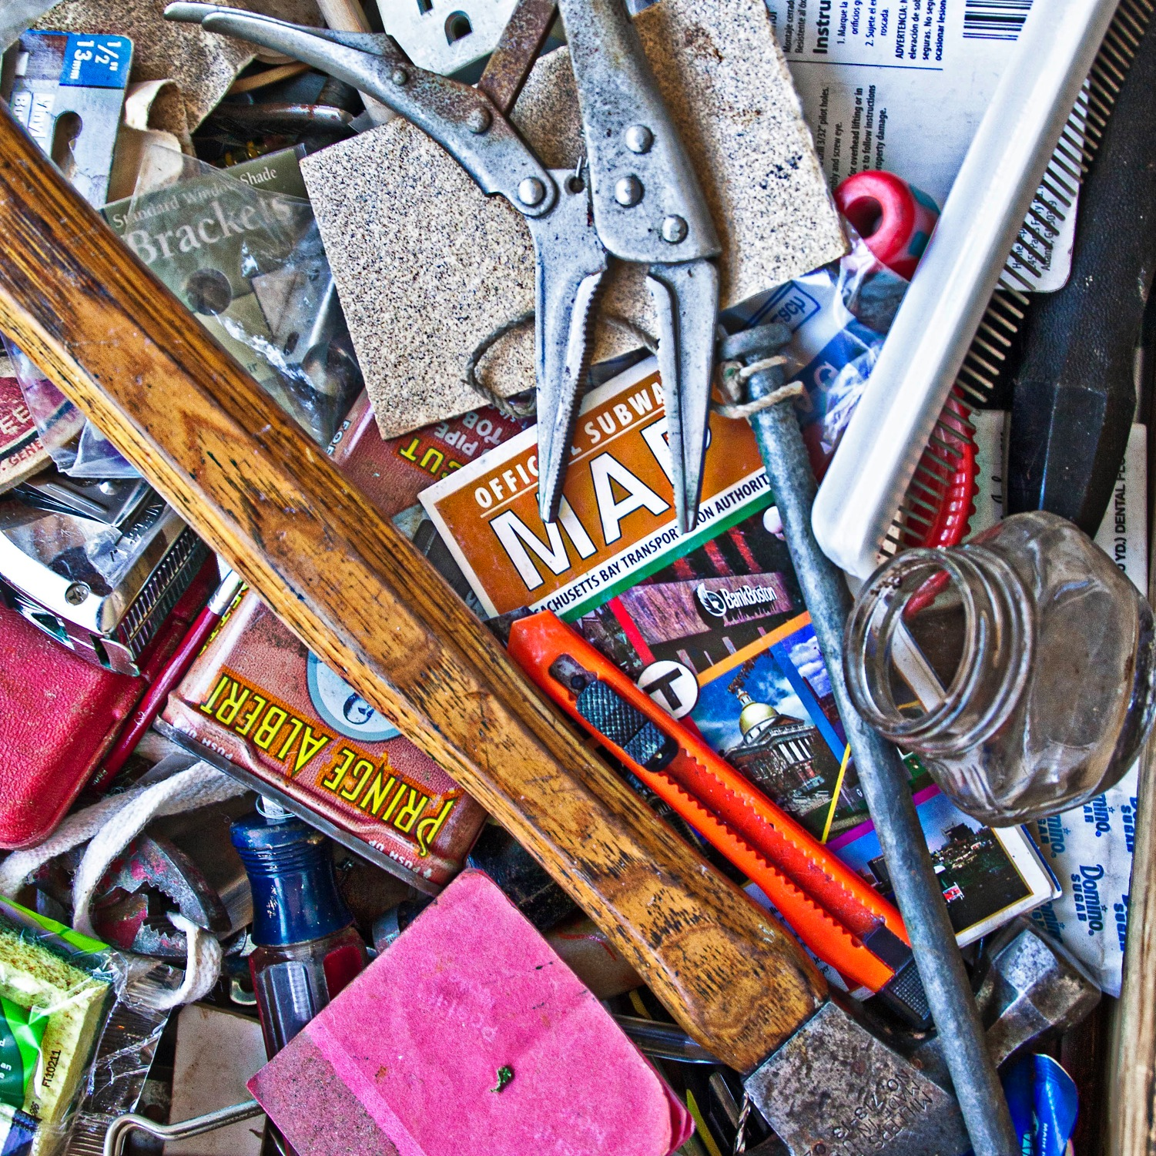
“one project’s junk is another project’s treasure”
flickr.com/calliope/9070783026
Notes:
But there is so much more to the code we write. To all the code that we leave behind. It embodies our limitations and our strengths. It expresses our understanding of the world... and it expresses how we wish we could change the world.
We design and engineer architecture that represent ourselves. That express our opinions. And our body of work as a whole expresses what it is we love about the work that we do each day and the truths we sought.

Slide 56
JUNK
@franklinwebber
flickr.com/calliope/9070783026
Notes:
The most interesting thing I found on this journey to answer my questions is that I think I had it wrong. The code core critical to the mission was the junk -- because from what I saw, the junk we write was universal.
So I'm asking that the next time you return to your current coding obsession or project and look for your junk. Rid yourself of it if you can -- and share it with all of us.

